Slide 1

DBMS COURSE PROJECT
FoodLink
Food Redistribution System
Connecting Donors with NGOs · Reducing Food Waste
MySQL · Node.js · React.js · Row-Level Locking
B.Tech CSE · DBMS Lab Project

Slide 2

🍲 Food Surplus Goes Unused
Hotels, restaurants & events discard tons of edible food daily — no channel to redirect it.
Problem
Statement
🏘️ NGOs Lack Discovery
Charitable organizations cannot easily discover available food near them in real time.
⚡ Race Conditions in Allocation
Multiple NGOs requesting the same limited food stock leads to data inconsistency without proper DB controls.
Why does this problem exist?
40%
📋 No Accountability Trail
Donations have no structured record — impossible to track what was given, when, and to whom.
of food produced in India is wasted

Slide 3






Our Solution
A full-stack DBMS-powered platform bridging food donors and NGOs
Donor Portal
NGO Dashboard
Concurrency Control
List surplus food with quantity, type, expiry, and location details
Browse prioritized food listings filtered by location & urgency
Row-level locking prevents double-allocation in simultaneous requests
3NF Database
Priority Algorithm
Partial Allocation
Normalized MySQL schema: Cities, Users, Food_Listings, Requests, Transactions
Auto-ranks food by expiry (<5h), pincode, city, and state proximity
Multiple NGOs share a single listing — no food goes untouched

Slide 4
Website Flow
Two-role system — every action flows through the database
DONOR
Signup as
Donor
Add Food
Listing
Set Expiry
& Location
View
Requests
Transactions
Logged
MySQL Database · Transactions · Row Locks
NGO
Signup as
NGO
Browse
Priority Feed
Submit
Request
Partial/Full
Allocation
Track &
Cancel
Every request flows through SQL transactions with row-level locking for concurrency safety

Slide 5
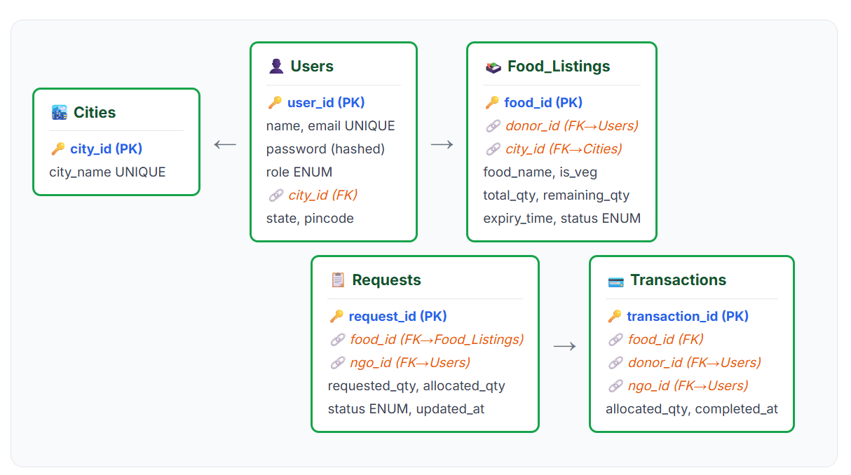
ER Diagram

Slide 6
Database Design (3NF)
All non-key attributes depend on the whole primary key — no transitive dependencies
Cities
city_id PK · city_name UNIQUE
Users
user_id PK · name · email UNIQUE · password
role ENUM('donor','ngo') · city_id FK · state · pincode · contact
Food_Listings
food_id PK · donor_id FK · food_name · food_type · is_veg
total_quantity · remaining_quantity · unit · expiry_time
city_id FK · state · pincode · status ENUM · description
Requests
request_id PK · food_id FK · ngo_id FK
requested_quantity · allocated_quantity
status ENUM('pending','approved','partially_approved','rejected','cancelled')
Transactions
transaction_id PK · food_id FK · donor_id FK · ngo_id FK
allocated_quantity · completed_at
🔗 All foreign keys reference parent tables with ON DELETE CASCADE / SET NULL constraints

Slide 7
Normalization Applied
1NF
Atomic values, no repeating groups
→ Each column holds a single value — no comma-separated lists of NGO IDs or food items. Every row uniquely identified by its PK.
2NF
No partial dependencies on composite keys
→ No composite PKs — all tables use single-column surrogate PKs (user_id, food_id, etc.). Every non-key attribute fully depends on the PK.
3NF
No transitive dependencies
→ City data (city_name) moved to Cities table. Users only store city_id FK — city_name doesn't depend on user_id. Eliminates update anomalies.
Result: Eliminated insert / update / delete anomalies — single source of truth for city names and user roles

Slide 8
Constraints & Keys
Enforcing data integrity at the database layer
PRIMARY KEY
NOT NULL
Unique identifier for every table (user_id, food_id, request_id …)
name, email, password, total_quantity, expiry_time — mandatory fields
FOREIGN KEY
DEFAULT
Referential integrity: donor_id → Users, city_id → Cities, ngo_id → Users
created_at / completed_at use CURRENT_TIMESTAMP — no manual inserts needed
UNIQUE
ON DELETE CASCADE
email in Users — prevents duplicate registrations
Deleting a donor removes all their food listings and requests automatically
ENUM
CHECK (implicit)
role: ('donor','ngo') · status: ('available','partially_allocated','fully_allocated','expired')
remaining_quantity ≤ total_quantity enforced via application + transaction logic

Slide 9
Concurrency Control
The Race Condition Problem
⚠ Scenario: Food listing has 10 kg remaining. Two NGOs request 8 kg simultaneously.
NGO-A Thread
Database State
NGO-B Thread
SELECT remaining = 10
10 kg available
10 kg available
SELECT remaining = 10
Decides: allocate 8 kg
10 kg available
10 kg available
Decides: allocate 8 kg
UPDATE remaining = 2 ✓
❌ NOW 2 kg
❌ -6 kg !!
UPDATE remaining = -6 ✗

Slide 10
Concurrency Control
Solution: SQL Transactions + Row-Level Locking (SELECT … FOR UPDATE)
Backend — routes/requests.js
BEGIN TRANSACTION
1
await conn.beginTransaction();
Wraps all DB operations in a single atomic unit
// Row-level lock — blocks other writers
const [rows] = await conn.query(
2
SELECT … FOR UPDATE
`SELECT * FROM Food_Listings
Acquires a row-level exclusive lock — other transactions block here
WHERE food_id = ?
FOR UPDATE`, [food_id]
);
3
Read & Compute
// Safe: only one thread reads at a time
Safely read remaining_qty and compute allocation amount
const allocated =
Math.min(requested, remaining);
UPDATE + INSERT
4
await conn.query(UPDATE Food_Listings ..);
Decrement remaining_qty, insert Request row, insert Transaction row
await conn.query(INSERT INTO Requests ..);
await conn.query(INSERT INTO Transactions);
5
COMMIT / ROLLBACK
await conn.commit();
Lock released — next queued transaction can now proceed
Guarantee: remaining_quantity can never go negative — even under 100 concurrent requests

Slide 11
ACID Transactions
Every food allocation is wrapped in a database transaction
A
C
Atomicity
Consistency
All three operations succeed together or all roll back: UPDATE Food_Listings, INSERT Requests, INSERT Transactions. No partial state.
remaining_quantity is always ≥ 0. Status transitions (available → partially_allocated → fully_allocated) are enforced within the same transaction.
I
D
Isolation
Durability
SELECT … FOR UPDATE ensures concurrent NGO requests serialize. One sees stale data unless the lock is released — prevents dirty reads.
Once committed, the allocation record in Transactions is permanent. Even a server crash cannot undo a completed donation.

Slide 12
SQL Joins & Priority Query
Multi-table JOIN with computed priority score using CASE expression
/api/food GET — NGO Browse Query
Priority Score Breakdown
SELECT f.*, c.city_name, u.name AS donor_name,
4
Expiry ≤ 5 hours
CASE
WHEN f.expiry_time <=
Highest urgency — shown first
DATE_ADD(NOW(), INTERVAL 5 HOUR)
THEN 4 -- expiry urgent
3
Same Pincode
WHEN f.pincode = ? THEN 3 -- same pin
Nearest food geographically
WHEN f.city_id = ? THEN 2 -- same city
WHEN f.state = ? THEN 1 -- same state
2
Same City
ELSE 0
Local availability
END AS priority_score
FROM Food_Listings f
1
Same State
LEFT JOIN Cities c ON f.city_id = c.city_id
Regional fallback
LEFT JOIN Users u ON f.donor_id = u.user_id
WHERE f.status IN ('available','partially_allocated')
0
Other
AND f.expiry_time > NOW()
ORDER BY priority_score DESC, f.expiry_time ASC;
Shown last
Also uses: LEFT JOIN across 3 tables · parameterized queries (prevents SQL injection) · indexed status + expiry_time columns

Slide 13


Authentication & Authorization
Password Hashing
JWT Tokens
Role-Based Access
bcryptjs with salt rounds = 10
Signed with server secret
requireRole('donor') middleware
Plaintext password never stored
7-day expiry window
requireRole('ngo') middleware
Hash comparison on login
Payload: user_id, role, city_id
403 Forbidden on role mismatch
Brute force resistant
Stateless — no session store
Route guards in React frontend
Frontend: Axios interceptor automatically attaches Bearer token to every API request — no manual token management in components

Slide 14
Tech Stack
Frontend
Backend
Database
React 18 + Vite
Node.js + Express 4
MySQL 8.0
Tailwind CSS 3
mysql2 (promise pool)
5 normalized tables (3NF)
React Router v6
bcryptjs (password hash)
Row-level locking (FOR UPDATE)
Axios + JWT interceptor
jsonwebtoken (JWT)
SQL Transactions (ACID)
react-hot-toast
CORS middleware
Foreign key constraints
lucide-react icons
RESTful API design
ENUM + AUTO_INCREMENT
React ↔ Axios → Express (JWT auth) → MySQL Connection Pool → Transactions → Response

Slide 15

Summary
3NF Normalization
Transactions (ACID)
Cities table separated; no transitive dependencies across 5 tables
BEGIN → lock → read → write → COMMIT atomically
Primary & Foreign Keys
Row-Level Locking
Referential integrity enforced with CASCADE / SET NULL
SELECT … FOR UPDATE prevents race conditions in concurrent allocation
ENUM & Constraints
Partial Allocation
Role, status columns restricted at DB level; NOT NULL on critical fields
MIN(requested, remaining) with status tracking across multiple NGOs
SQL Joins
3-table LEFT JOIN with dynamic CASE priority scoring
FoodLink — Reducing Food Waste with DBMS · Thank You

